Slide 1
Integer Numbers
p.37-60

Slide 2
Success Criteria
Students will be able to perform any operation with negative numbers (add, subtract, multiply, divide)

Slide 3
What is an integer?
An integer is ANY whole number, including negatives.
0, 1, 2, 3,… are called Natural numbers
… -2, -1, 0, 1, 2,… are called Integer numbers

Slide 4
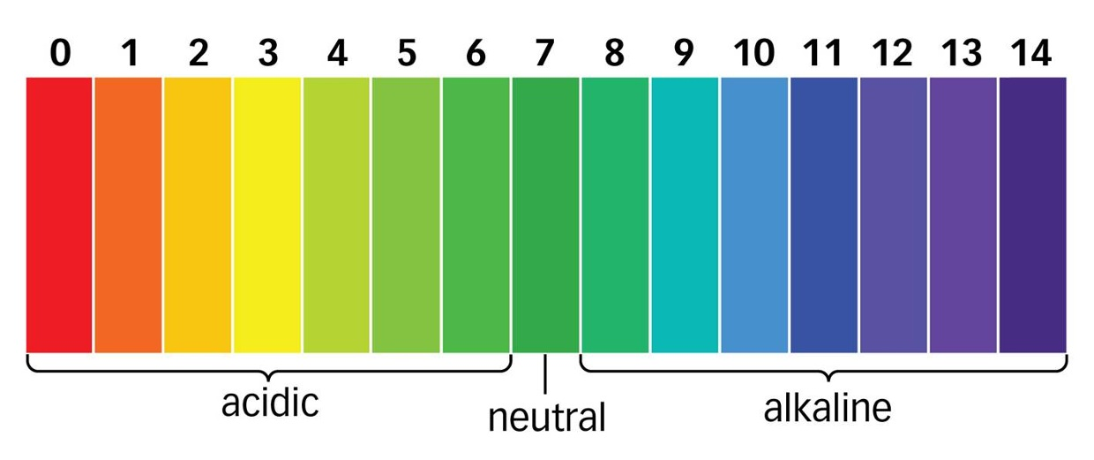
Number line
A number line may help us understand integer numbers.

Slide 5
Homework
P.43-44 #12-15
For #15, the format is: (year of birth, year of death)
Example for Jesus: (1, 33)

Slide 6
Answers
#15
A) Vercingetorix
B) Augustus
C) Cleopatra
D) Augustus

Slide 7
Adding + Subtracting Integers
12 + (-3) =
8 + (-12) =
-7 + 4 =
-3 + 5 =

Slide 8
Adding + Subtracting Integers
12 - (-3) =
8 - (-12) =
-7 - 4 =
-3 - 5 =

Slide 9
Homework
P.47 #6
P.48 #14-16 (B.C. is like a negative year)
P.50 # 29-33

Slide 10
Homework Answers
#6: 3, 6, -2, -3, -13, 17, -12, 6, -1
#14: 30 BC
#15: -14ºC
#16: 5th floor

Slide 11
Homework Answers
#29: 80, 57, 53, 33
#30: 83 BC
#31: Augusta
#32: 0 years
#33: 55ºC

Slide 12
Multiplication of Integers
14 X 8 =
-14 X 8 =
14 X (-8) =
-14 X (-8) =

Slide 13
Exponents
4³
= 4 X 4 X 4
= 16 X 4
= 64

Slide 14
Exponents
(-4)³
= -4 X -4 X -4
= 16 X -4
= -64

Slide 15
Exponents
(-4)⁴
= -4 X -4 X -4 X -4
= 16 X -4 X -4
= -64 X -4
= 256

Slide 16
Division of Integers
14 / 8 =
-14 / 8 =
14 / (-8) =
-14 / (-8) =

Slide 17
Homework
P.53 #10, 14 (distributive property)
P.54 #18
P.55 #19, 20

Slide 18
Homework Answers
#10: 0, -3, 5, -6
#14: 25, -28, -28, -3, 9, -90
#18: -18, -48, -40, 25, 160, -648, 144, -96
#19: -11, 8, -6, 7
#20: -15, -9, 9, 5

Slide 19
Chains of Operations with Integers
Remember your BEDMAS
Write neatly
HOMEWORK: P.58 #10-14
ASSIGNMENT: P. 59 & P.60 (for marks)

Slide 20
Review for test
Work on your memory aid (single sided, 8.5”x11”)
Adding, subtracting, multiplying, dividing integers
BEDMAS
Chains of operations example

