Slide 1
Lines and Angles
p.115-143

Slide 2
Lines and segments
Recall:
B
A

Slide 3
Lines and segments
Recall:
B
A

Slide 4
Lines and segments
Recall:
B
A

Slide 5
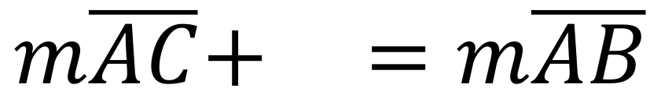
Lines and segments
Recall:
B
C
A
$$m\overline{AC}+ =m\overline{AB}$$

Slide 6
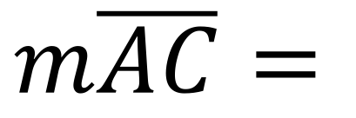
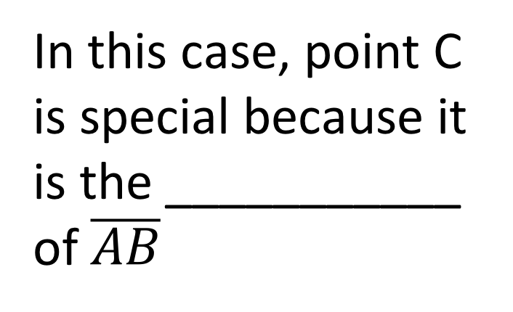
Lines and segments
In this case, point C is special because it is the ___________ of $\overline{AB}$
B
C
A
$$m\overline{AC}=$$

Slide 7
Angles
Angles tell us how far around we have gone around a circle.
Angles are measured in degrees
^{O}C

Slide 8
Angles
We can use angles to help us describe any 2D shape.
The sum of interior angles in a triangle is 180^{O}
The sum of interior angles in a quadrilateral is 360^{O}

Slide 9
Angles

Slide 10
Measuring an angle
Protractors are like rulers but for angles.
You must bring one to every class!

Slide 11
Homework
P.121-124
IXL

Slide 12
Positions of lines

Slide 13
Positions of lines

Slide 14
Positions of lines

Slide 15
Positions of lines

Slide 16
Homework
p.127-129
IXL

Slide 17
Right bisector
A right bisector is a line that passes through the midpoint of a line segment at a perpendicular angle.
B
A

Slide 18
Angle bisector
An angle bisector is a ray that divides an angle into two equal angles.
60^{O}

Slide 19
Angle bisector
An angle bisector is a ray that divides an angle into two equal angles.
30^{O}
30^{O}

Slide 20
Vertically opposite Angles
Intersecting lines produce vertically opposite angles.
Vertically opposite angles are congruent.

Slide 21
Homework
P.131, 134, 135 up to #8
IXL

Slide 22
Complementary angles
When two angles add up to 90^{O}, they are called complementary angles

Slide 23
Supplementary angles
When two angles add up to 180^{O}, they are called supplementary angles

Slide 24
Homework
The rest of p.135, 136, 138 up to #17
IXL

Slide 25
Parallel Lines cut by a transversal

Slide 26
Parallel Lines cut by a transversal

Slide 27
Parallel Lines cut by a transversal

Slide 28
Homework
P.139, #18-19
P.140
IXL

Slide 29
In-class assignment
p.141-143
When you are done, you may work on IXL

Slide 30
Review for test
Handwritten memory aid, 8.5”x11”, single-sided
Lines, rays, segments
Angles (all six types)
Intersecting, parallel, perpendicular lines
Right bisector, angle bisector
Vertically opposite angles
Complementary & supplementary angles
Parallel lines cut by a transversal
IXL

