Slide 1
Perimeter and Area

Slide 2
Why should we learn about perimeter and area?
Often found in:
  Construction(tiling, roofing, fencing, painting)
  Engineering (technical drawings, material sciences)
  Landscaping (grass beds, flower beds, shrubs, trees)
Allows us to calculate volume in 3D figures (Sec II-V)
Used in dilatations and similar figures (Sec II-IV)
Appears in EVERY situational problem for the final exam in June

Slide 3
Learning Intentions
Students will appreciate the metric system as a system of measurement founded on multiples of 10.
Students will understand the perimeter of polygons.
Students will understand area of polygons.

Slide 4
Success Criteria
Students will be able to convert metric units from kilo to milli and all prefixes in between.
Students will be able to calculate the perimeter of any quadrilateral, triangle, or regular polygon.
Students will be able to calculate the area of any quadrilateral, or triangle; as well as certain irregular polygons.

Slide 5
Metric System (p.217)
Used day-to-day in 190/193 countries in the world.
Exceptions: Myanmar, Liberia, and the United States.
Used in every country for the scientific community
Uses multiples of ten for the following prefixes:
Kilo-, Hecto-, units, Deci-, Centi-, Milli-

Slide 6
Metric System (p.217)
Kilo-, Hecto-, Deca-, units, Deci-, Centi-, Milli-
Pneumonic: King Henry Died, Mother Didn’t Care Much.
Works for any base unit:
Kilometer, Hectometer, Decameter, meter, Decimeter, Centimeter, Millimeter
Kilogram, Hectogram, Decagram, gram, Decigram, Centigram, Milligram
Kiloliter, Hectoliter, Decaliter, liter, Deciliter, Centiliter, Milliliter

Slide 7
Metric System (p.217)
Kilometer, Hectometer, Decameter, meter, Decimeter, Centimeter, Millimeter
When going from left to right, for each step, multiply by 10.
When going from right to left, for each step, divide by 10.
Convert 15 cm to meters:
Convert 7 km to mm:

Slide 8
Metric System (p.217)
Kilometer², Hectometer², Decameter², meter², Decimeter², Centimeter², Millimeter²
When going from left to right, for each step, multiply by 100.
When going from right to left, for each step, divide by 100.
Convert 18 dm² to dam²:
Convert 5 hm² to cm²:

Slide 9
Homework
P.217-218, #3-11
P.219, #12-16
Math-Aids Package (3 pages), show your work

Slide 10
Perimeter of a Polygon (p.221)
We’ve seen triangles (3 sides)
We’ve seen quadrilaterals (4 sides)
Polygon comes from the Greek words poly (many) and gon (sides)
A polygon is any figure with 3 to infinite sides.
For all polygons, the perimeter is equal to the sum of all sides.

Slide 11
Perimeter of a Polygon
Recall that, in a parallelogram, opposite sides are equal.
Therefore, the perimeter of a parallelogram = a + a + b + b = 2a + 2b
a
b

Slide 12
Perimeter of a Polygon
Recall that all rectangles are parallelograms.
Therefore, the perimeter of a rectangle = a + a + b + b = 2a + 2b
a
b

Slide 13
Perimeter of a Polygon
Recall that all rhombus are parallelograms.
Therefore, the perimeter of a rhombus = a + a + b + b = 2a + 2b
However, all four sides are equal, so a = b
Perimeter = a + a + a + a = 4a
a
b

Slide 14
Perimeter of a Polygon
Recall that all squares are parallelograms.
Therefore, the perimeter of a square = a + a + b + b = 2a + 2b
However, all four sides are equal, so a = b
Perimeter = a + a + a + a = 4a
a
b

Slide 15
Perimeter of a Polygon
If a polygon is regular (all sides equal), like a rhombus or square, the perimeter is always equal to the number of sides times the side length.
Square, 4 sides, perimeter = 4s
Rhombus, 4 sides, perimeter = 4s
Pentagon, 5 sides, perimeter = 5s
Hexagon, 6 sides, perimeter = 6s
Octagon, 8 sides, perimeter = 8s
Hectogon, 100 sides, perimeter = 100s

Slide 16
Homework
P.222-223, #1-12 (except #4) (show your work with the formula)
For #2, same principle but with letters.
Ex: 2a) Perimeter = a + a + a = 3a
Ex: 2h) Perimeter = 2 + 1 + x + 2 + x + 1 = 6 + 2x
Refer to p.221 (excellent for memory aid)

Slide 17
Area of a Polygon (p.226)
Recall that the area of rectangle is b X h
h
b

Slide 18
Area of a Polygon (p.226)
Recall that the area of rectangle is b X h
Recall that all squares are rectangles, so area = b X h
However, b = h; so area = b X b = b²
h
b

Slide 19
Area of a Polygon (p.226)
Recall that the area of rectangle is b X h
What type of figure would we get if we cut the shape along a diagonal?
The rectangle is cut in half. What is the area of the new figure?
h
b

Slide 20
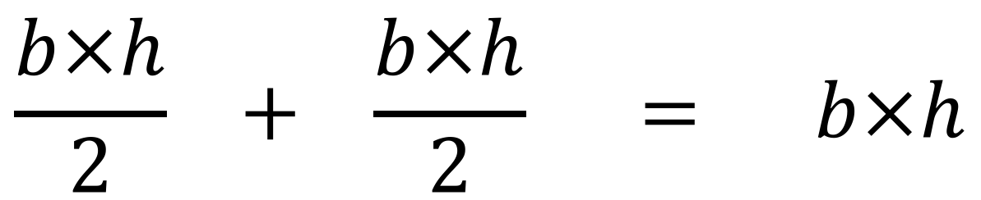
Area of a Polygon (p.226)
$$\frac{b×h}{2} + \frac{b×h}{2} = b×h$$

Slide 21
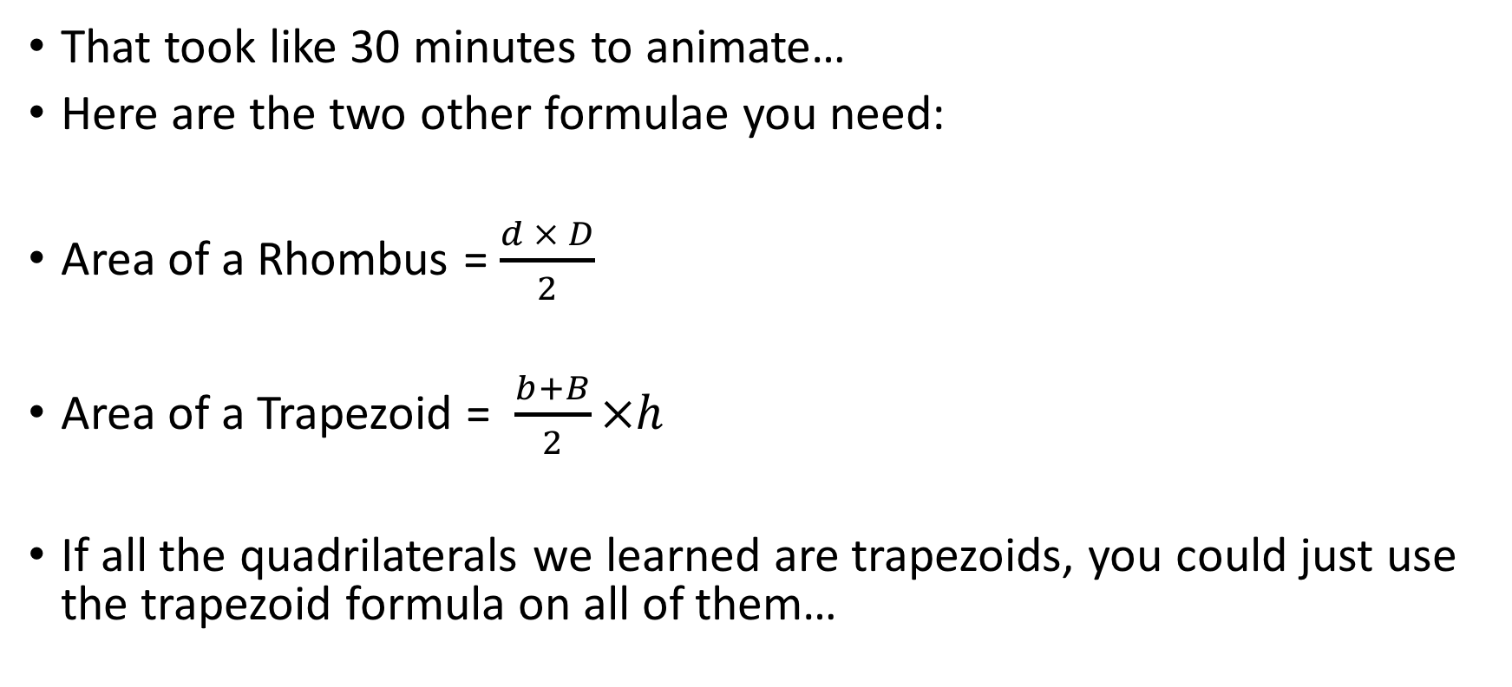
Area of a Polygon (p.226)
That took like 30 minutes to animate…
Here are the two other formulae you need:
Area of a Rhombus = $\frac{d × D}{2}$
Area of a Trapezoid = $\frac{b+B}{2}×h$
If all the quadrilaterals we learned are trapezoids, you could just use the trapezoid formula on all of them…

Slide 22
Homework
p.227-228, #1-14 (show your work with the formula)
Assignment: p.229-230 (except #8)
Must be completed on separate pages.
Due Wednesday, February 21st.
Test on Friday, February 23rd.
Memory Aid (include p.217, 221, 226)

