Slide 1
Triangles

Slide 2
Why should we learn about triangles?
Often found in:
Construction
Engineering
Useful to calculate unknown distances and angels
Map making
Astronomy
Space exploration
Architecture
Decorating

Slide 3
Success Criteria
Students will be able to find missing angles in a triangle
Students will be able to recognize:
Types of triangles
Properties of triangles
Students will be able to construct triangle images by
Rotation
Transformation
Translation

Slide 4
Today’s Success Criteria
Students will be able name the sides of a triangle
Students will be able to find missing angles in a triangle

Slide 5
How can we recognize a triangle?

Slide 6
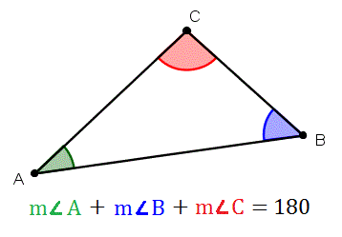
How can we recognize a triangle?
Three points, joined by three segments
Sum of interior angles = 180^{O}

Slide 7
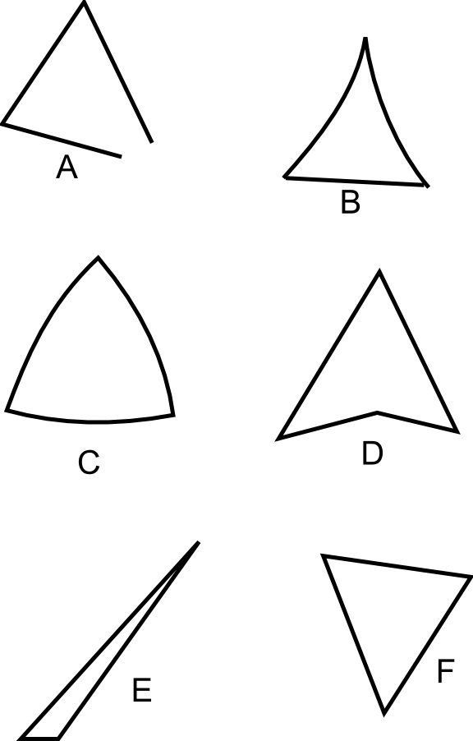
Which ones are triangles?

Slide 8
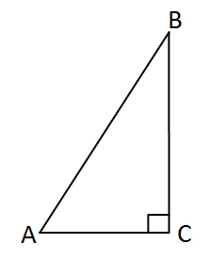
Naming Triangles
The sides of a triangle are segments so we name them as segments.
The angles are named as usual, three letters with the vertex as the second letter.

Slide 9
Naming Triangles
The sides of a triangle are segments so we name them as segments
The angles are named as usual, three letters with the vertex as the second letter.

Slide 10
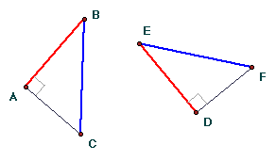
For each triangle, give the name of the longest side and largest angle. Use a ruler.

Slide 11
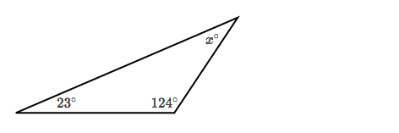
Find missing angles
Sum of interior angles = 180^{O}

Slide 12
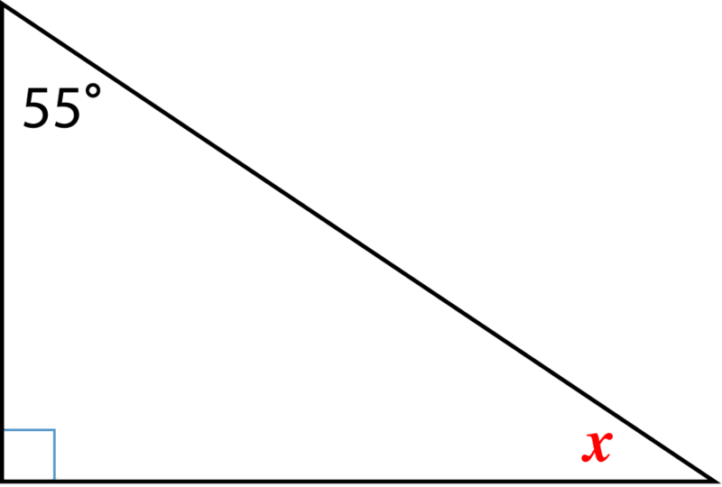
Find missing angles
Sum of interior angles = 180^{O}

Slide 13
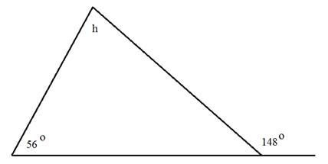
Find missing angles
Sum of interior angles = 180^{O}

Slide 14
Homework
P.168-169, #1-3

Slide 15
Today’s Success Criteria
Students will be able to prove, using angles, which side of a triangle is the largest side.

Slide 16
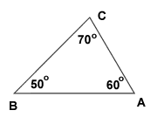
Properties of Triangles
The largest side is opposite the largest angle.

Slide 17
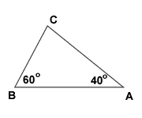
Properties of Triangles
The largest side is opposite the largest angle.

Slide 18
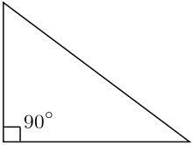
Properties of Triangles
The largest side is opposite the largest angle.

Slide 19
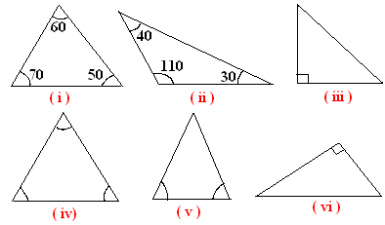
Properties of Triangles
The largest side is opposite the largest angle.

Slide 20
Homework
P. 169 Activity 2, #5 a,b

Slide 21
Constructing a Triangle
Read P.170 (Constructing a Triangle)
Complete P. 171 (angle BCA = 70^{O})
IXL
Remainder of P.171 is homework

Slide 22
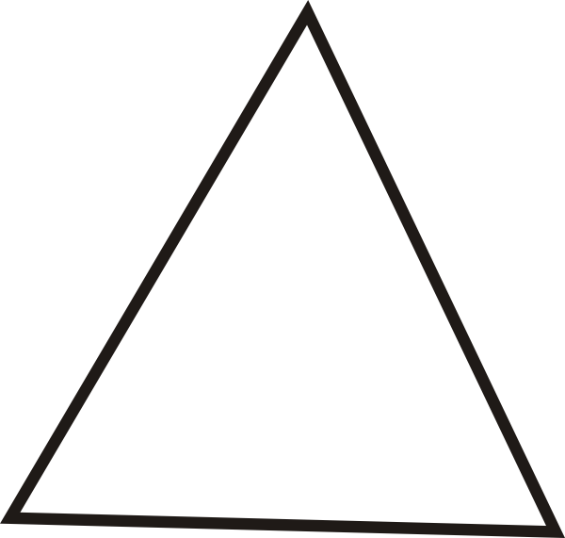
Special Lines – height (altitude)
Perpendicular segment from a vertex to a side.
Three heights intersect at the orthocenter.

Slide 23
Special Lines – height (altitude)
Perpendicular segment from a vertex to a side.
Three heights intersect at the orthocenter.

Slide 24
Special Lines – median
Segment from a vertex to a midpoint.
Three medians intersect at the center of gravity.

Slide 25
Special Lines – median
Segment from a vertex to a midpoint.
Three medians intersect at the center of gravity.

Slide 26
Special Lines – right bisectors
Lines passing through a midpoint at a right angle.
Three right bisectors intersect at the center of a circle that circumscribes the triangle.

Slide 27
Special Lines – right bisectors
Lines passing through a midpoint at a right angle.
Three right bisectors intersect at the center of a circle that circumscribes the triangle.

Slide 28
Special Lines – angle bisectors
Lines passing through a vertex which bisect the angle (cut in half).
Three angle bisectors intersect at the center of a circle that is inscribed in the triangle.

Slide 29
Special Lines – angle bisectors
Lines passing through a vertex which bisect the angle (cut in half).
Three angle bisectors intersect at the center of a circle that is inscribed in the triangle.

Slide 30
Homework
P.174-176
EXCLUDING: #5, 7, 10

Slide 31
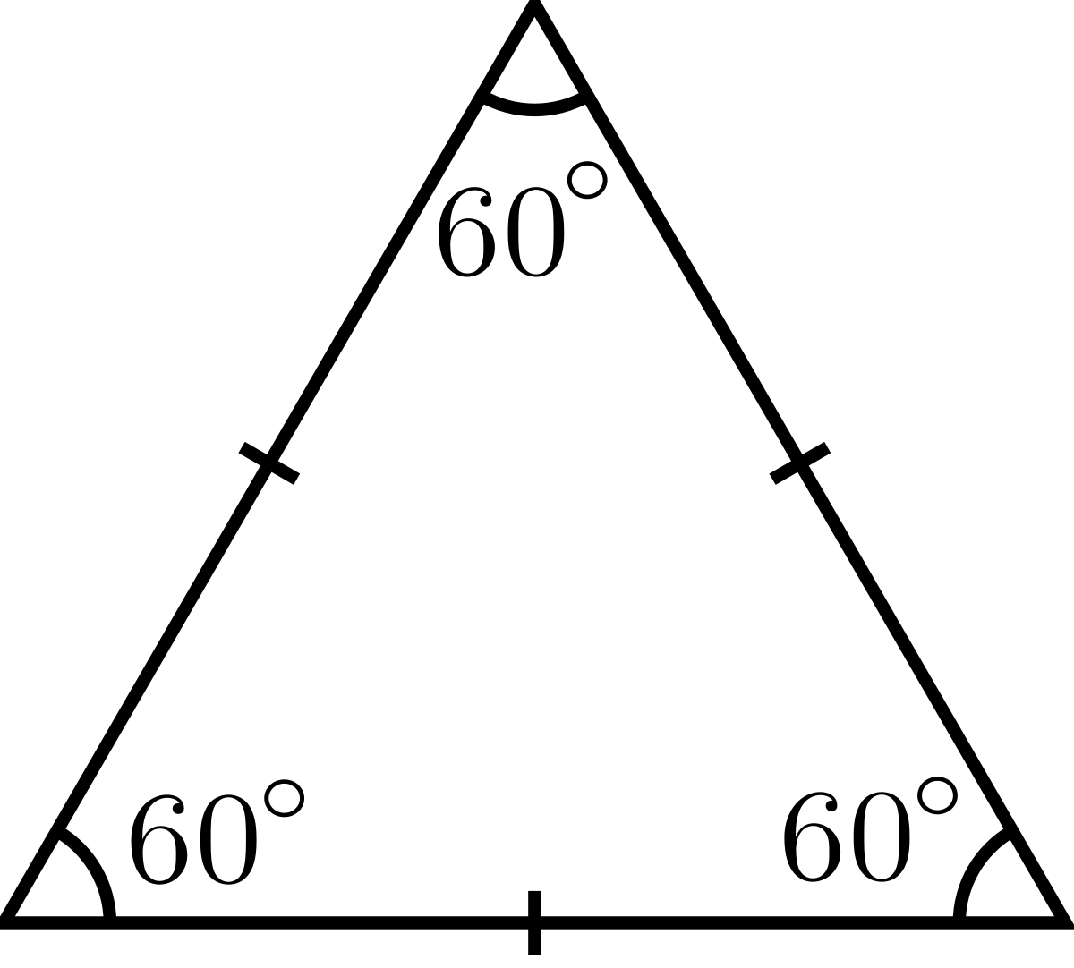
Special Triangles (by side) – Equilateral
Three congruent (equal) sides
Because the largest side is opposite the largest angles, all angles are equal (60^{O})

Slide 32
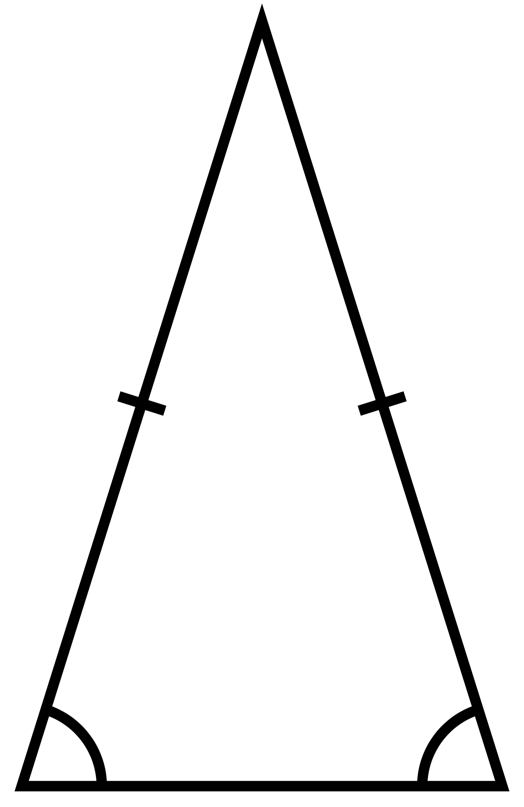
Special Triangles (by side) – Isosceles
Two congruent (equal) sides
Because the largest side is opposite the largest angles, the base angles are congruent.

Slide 33
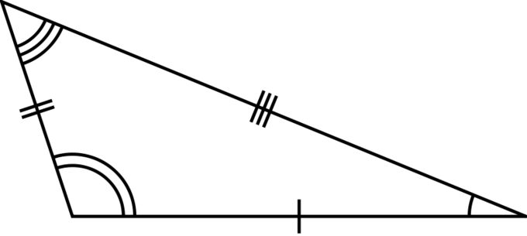
Special Triangles (by side) – Isosceles
None of the sides are congruent.
None of the angles are equal.
AKA the annoying triangle that nobody likes because he’s different.

Slide 34
Special Triangles (by angle) – Right
One angle of 90^{O} (Why can’t you have two angles of 90^{O}?)
Side opposite the right angle is called the hypotenuse
The two acute angles are complimentary (Why?)

Slide 35
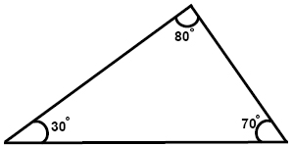
Special Triangles (by angle) – Acute
All three angles are acute.

Slide 36
Special Triangles (by angle) – Obtuse
One angle is obtuse.

Slide 37
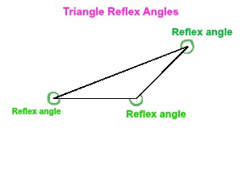
Special Triangles (by angle) – Reflex
One angle is reflex. But three is better.

Slide 38
Special Triangles (combination)
Label the triangles types below. You may use a ruler and a protractor.

Slide 39
Special Triangles (combination)
Label the triangles types below. You may use a ruler and a protractor.

Slide 40
Homework
P.179 #1 only
P.180-181
EXCLUDING: #11

Slide 41
Problems with Triangles
P.182 #1,2
P.183-184 #5,6
ASSIGNMENT: P.186-187
Due at the start of class on Monday

Slide 42
Review for Test on Wednesday
Memory aid
Angle relationships from lines and angles (ex: vertically opposite angles)
Finding missing angles in a triangle (hint: sum of angles in a triangle is 180^{O})
Properties of triangles (ex: the largest side is opposite the largest angle, the sum of two sides is greater than a single side)
Properties of special triangles (equilateral, isosceles, scalene)
Special lines in a triangle (height/altitude, median, right bisectors, angle bisectors AND what the points are called where they intersect)
Constructing triangles with sides and/or angles given
Names of all six special triangles

