Slide 1
Temperature

Slide 2
Celsius Scale
Celsius $(°C)$ is the international unit for temperature
Temperature is measured with a thermometer
0 $°C$ is the temperature at which water freezes
100 $°C$ is the temperature at which water boils

Slide 3
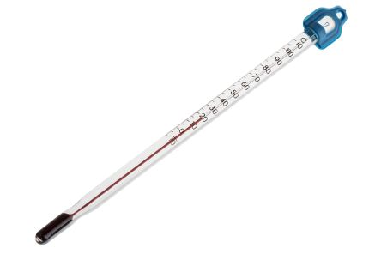

Slide 4
How does a thermometer work?
Particle theory
We know that the particles in a gas are more spread out than the particles in a liquid. As liquids increase in T/E, the particles begin speed up and to spread out even before they become a gas.
The more the particles spread out, the more volume they take up. The forces the liquid in the thermometer to take more space and move up the thermometer.

Slide 5
Acidity and Alkalinity

Slide 6
Acidity and Alkalinity
ALL liquids may be classified as either acids, bases, or neutrals.
Solids and gases, once dissolved in a liquid, will also become acids, bases, or neutrals.
In HIGH concentrations, acids and bases are dangerous to animals and the environment.

Slide 7
How can we tell what is an acid or a base?
Indicators are specific chemicals which change colour when brought into contact with acids or bases.
Ex: Litmus paper in Monday’s lab, red cabbage juice from demo a couple weeks ago.

Slide 8
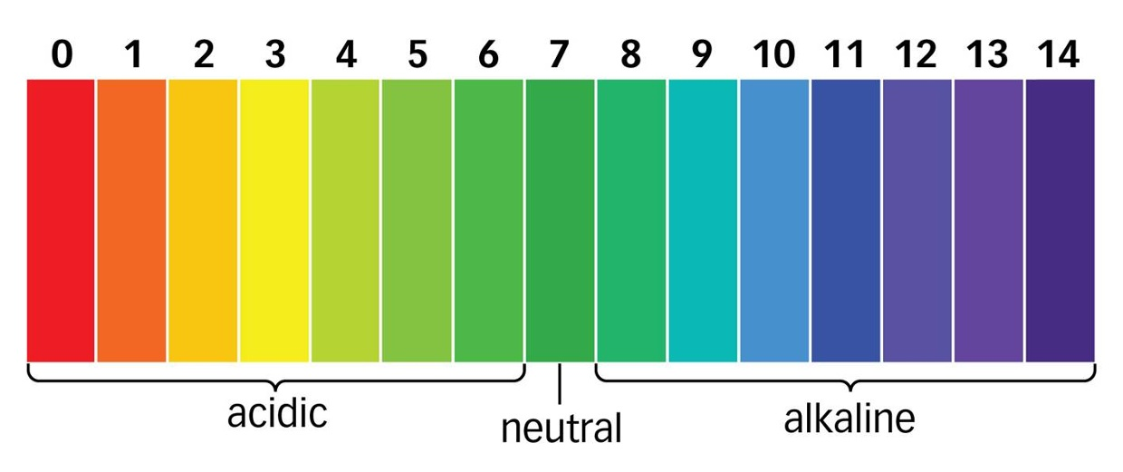
Relative Strength
There are strong acids, weak acids, weak bases, and strong bases.
We can determine these strengths with the pH scale:

Slide 9
More accurate indicators
While Litmus paper may only tell us if a liquid is acidic, basic, or neutral, Universal Indicator Paper (pH paper) may actually give us the specific pH number.

Slide 10
Characteristic Properties of Matter

Slide 11
Characteristic Properties of Matter
Imagine you are an investigator at a crime scene. You find a mysterious white powder. Tasting it could be dangerous. How do you determine what it is?
Characteristic properties are measurements which are true only for one specific substance in the universe.

Slide 12
Examples
Density
Ag (10.49 g/mL), Water (1.00 g/mL)
Melting Point
Al (660C), Au (1064C), Water (0C)
Boiling Point
Hg (357C), Water (100C)

Slide 13
Homework
Memory Check on p.193

