Slide 1
The Scope of Human Sexuality

Slide 2
Reminder
If you have a question that you want to ask outside of friends, family, or class, text your question to SextEd.
514-700-4411
100% Free (with a regular texting plan)
100% Anonymous

Slide 3
Ethical Question:
Should people be allowed to choose their
bathroom?
Is a unisex or gender-neutral bathroom a fair compromise?
Gavin Grimm: https://www.youtube.com/watch?v=M6t6hpe3w0M

Slide 4
Sexual Growth

Slide 5
Success Criteria
Students will appreciate the effects of hormones on emotions and develop strategies to manage emotions.
Students will question the notion of an attractive body image.
Students will take a position on public exposure of nipples.

Slide 6
Biochemistry & Puberty
Puberty prepares the body for sex
Puberty is initiated when the Brain’s pituitary gland sends the signal to release hormones
In biological females, there are two hormones
  Estrogen and Progestin
In biological males, there is one hormone
  Testosterone

Slide 7
Biochemistry & Puberty
Hormones do many things, but we will focus on the emotional dimension of their effects
Hormone levels vary on a daily, and even hourly, basis.
Sharp increases or decreases in hormone levels can lead to anxiety, depression, anger and, in some cases, thoughts of suicide.

Slide 8
Managing our Changing Emotions
Being able to manage our feelings is important to preserve relationships (friends, loved ones, teachers, etc.)
If you are feeling anxious or angry, give yourself a break.
It is important to be clear about how you feel so people can give you space.
  “I’m not in the mood for _______ right now. Can we do this later?”
  “I feel stressed. Can I take a walk and come back?”

Slide 9
Managing our Changing Emotions
If you are feeling depressed or unhappy, you may use a similar strategy.
  “I’m not in the mood for _______ right now. Can we do this later?”
  “I can’t do this right now. Can I take a walk and come back?”
It is VERY normal to feel down some days, especially after a disappointing event (ex: a break-up, a bad mark on a test, someone breaks a commitment)

Slide 10
Managing our Changing Emotions
If you are feeling unhappy, it is important to have at least one person to vent to.
  Cats and dogs are a last resort, dialogue with another human is healthier
If you feel unhappy for more than a couple weeks, with no signs of starting to feel better, you MUST ask for help from a school staff member or a medical professional.
  There may be a chemical imbalance that is literally preventing you from the ability to feel happy or fulfilled

Slide 11
Body Image
Healthy Body vs Attractive Body
The only person who can tell you if you are healthy or not is your doctor.
The only person who should judge if your body is attractive or not is you.

Slide 12
Body Image
Unfortunately, everyone will judge you as attractive or not within 3 seconds of seeing you.
It is impossible to be perceived as attractive by everyone, so we must learn to be comfortable in our own bodies.
Avoid justifying diets using health as a reason. Only a nutritionist, referred by your doctor, should put you on a diet.
Doctors will not normally recommend diets before the age of 18.

Slide 13
Body Image
What makes someone attractive?

Slide 14
Body Image
What makes someone attractive?

Slide 15
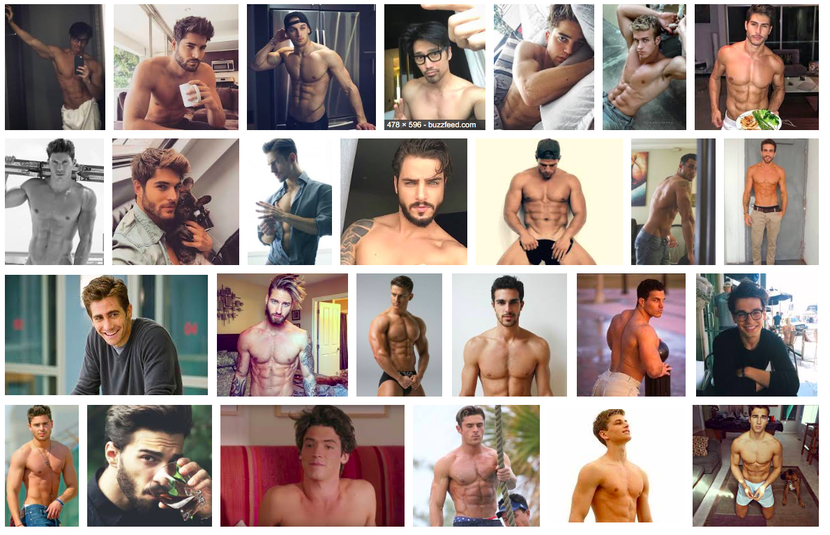

Slide 16
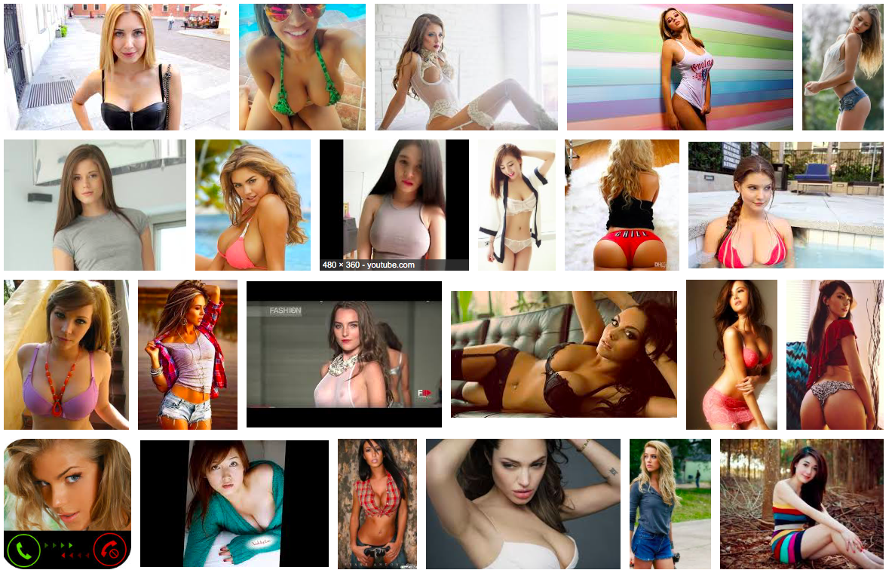

Slide 17
Ethical Question:
When can we show nipples?
Who’s nipples are offensive?
What about breast-feeding?
The next slide has nipples on it.

Slide 18
