Slide 1
Transformation of Matter

Slide 2
Physical Changes
Changes which do not produce a new substance
  Cutting, tearing, peeling, grinding
  Dissolving
  All changes of state

Slide 3
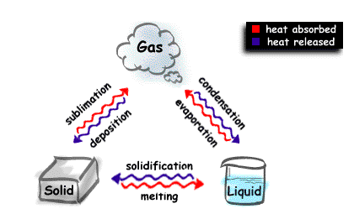
Changes of State

Slide 4
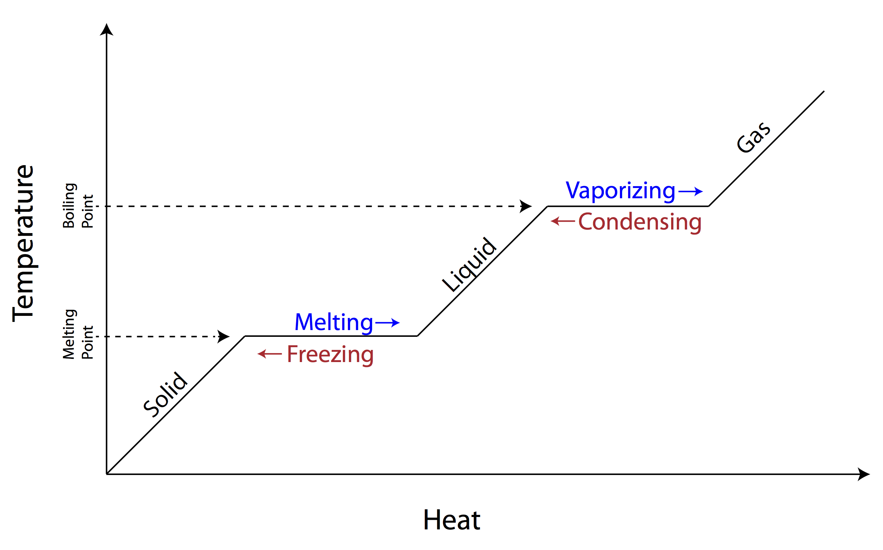
Temperature changes

Slide 5
Chemical Changes
Changes which produce a new substance
  Baking, burning, rusting, explosions
  There are clues to know if a new substance is produced:
    A gas is formed
    A residue (precipitate) is formed
    Heat or light is produced
    A colour change occurs

Slide 6
Chemical Changes
  There are clues to know if a new substance is produced:
    A gas is formed
    A residue (precipitate) is formed
    Heat or light is produced
    A colour change occurs

Slide 7
Law of Conservation of Matter
Matter is neither created, nor destroyed. It may only be transformed from one form to another.
In other words: nothing is lost, nothing is created

Slide 8
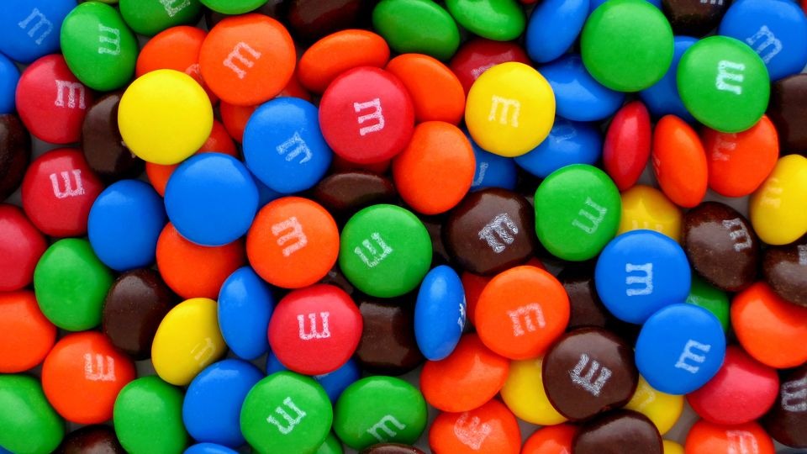
Heterogeneous Mixtures (see the different parts/phases)

Slide 9
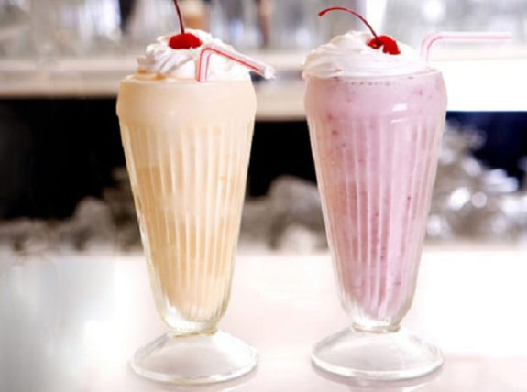
Homogeneous Mixtures – *NOT PURE SUBSTANCES

Slide 10
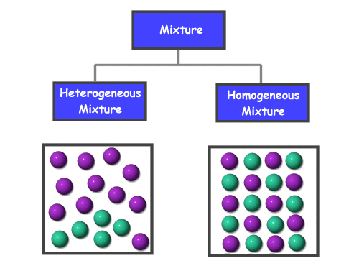
Particle Diagrams

Slide 11
Separation of Mixtures
Sedimentation
  Allow the mixture to settle into heterogeneous phases

Slide 12
Separation of Mixtures
Decantation
  Pour off one or more phases until the desired phase is left

Slide 13
Separation of Mixtures
Filtration
  Run the mixture through a filter designed to trap residue and allow the filtrate to flow through

Slide 14
Separation of Mixtures
Distillation
  Boil a liquid until the desired segment of the mixture remains

