Slide 1
Test Review
Transformation of Matter – SCI 104

Slide 2
Expectations
The test will begin promptly at 10:55AM on October 20th (Friday).
You are allowed to bring a pencil/pen and a calculator. Nothing else. No notes.
You may take the whole period to write the test. You may take period 4 to write the test if you need extra time. Same expectations.
Normally, violation of the class rules results in a tick. In a test environment, violation of the class rules will result in ejection from the class and, at the teacher’s discretion, a mark of 0 may be given for the whole test.
In the case that a student is caught cheating, the school’s regular cheating policy will apply and the student will automatically receive a mark of 0 of the test.
In this class, being in possession of a cellphone, or any device capable of receiving/transmitting information, during a test will automatically count as cheating. This includes if the device is turned off or put away. Leave it in your locker or give it to me at the start of class.

Slide 3
Temperature
Celsius Scale (Boiling/Freezing points of water)
How a thermometer works
Liquid in the thermometer expands as T increases, pushing liquid up the thermometer.

Slide 4
Acidity and Alkilinity
What is an indicator and how it works (colour changes)
You do not need to know the colour for each ph number
You DO need to be able to name at least three indicators (Litmus Paper, pH paper, red cabbage juice, Phenolphthalein solution, electronic pH meter)
Identify Strong/Weak Acids/Bases and neutrals with a pH number
Recognize the results of a litmus test

Slide 5
Characteristic Properties
Explain what a characteristic property is.
A property which is specific to only one substance.
Name the three characteristic properties covered in class.
Density, boiling point, melting point.
Use density to determine the composition of an unknown pure substance (d=m/v OR m=d*v OR v=m/d)

Slide 6
Physical Changes
Changes which do not produce a new substance
At least two examples (changes of state is one example)
Cutting, tearing, peeling, grinding
Dissolving
All changes of state

Slide 7
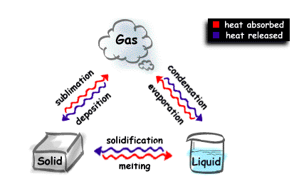
Changes of State
You must fill out all six labels in this diagram (no heat lables):

Slide 8
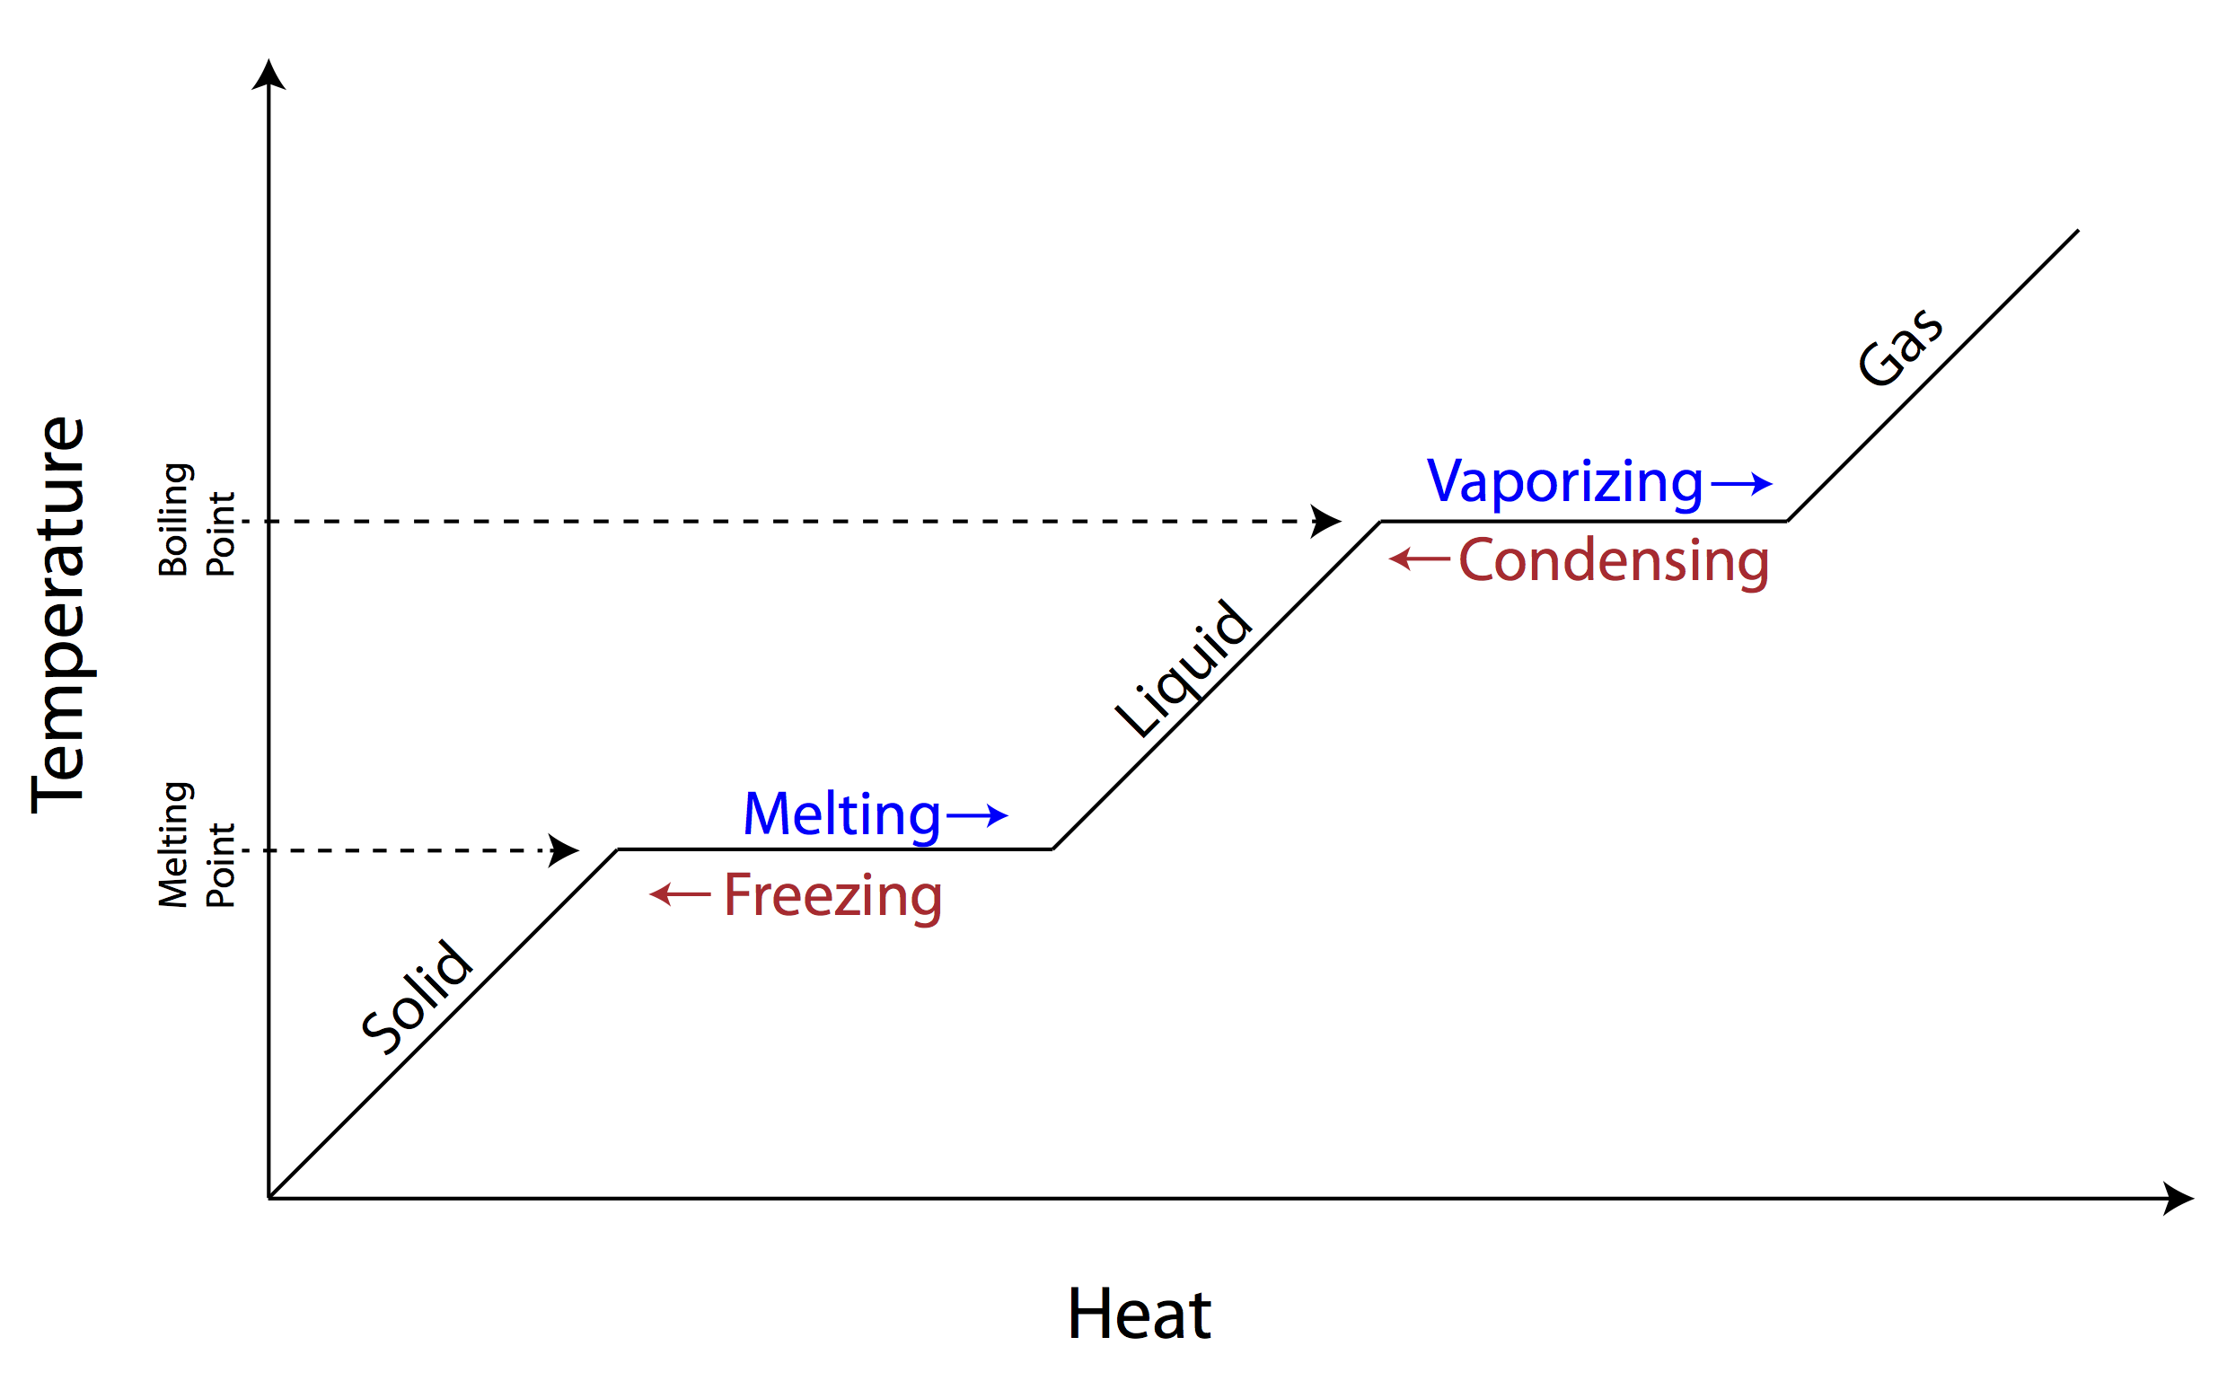
Changes of State
This will not be on your test. Be warned that it is often on the board exam.

Slide 9
Chemical Changes
Changes that produce a new substance
Give two examples
Baking, burning, rusting, explosions…
Give the four “hints”
Gas
Residue
Heat/Light
Change of Colour

Slide 10
Heterogeneous and Homogenous mixtures + separation techniques
Give examples of heterogeneous and homogeneous mixtures
Draw particle diagrams
Given a problem, choose the appropriate separation technique
Sedimentation
Decantation
Filtration
Distilation

Slide 11
Challenge Question
Law of Conservation of Matter (Conservation of Mass)

Slide 12
All this gets you 90%....
About 10% of the test is based on whether or not you may apply your knowledge in a NEW situation which you have not seen before.
How are we supposed to do something that we’ve never seen before?????
Answer: that’s life. We are checking for a deep understanding of the concepts taught in class.

Slide 13
Test taking tips
If you are unsure about a question, skip it, come back to it at the end of the test. Sometimes you can remember something afterwards and go back to it.
If you do not understand a question, ask the teacher. The worst thing that can happen is that they can’t help you.
Plan to take about 10 minutes per page. 40 minutes / 4 pages = 10 minutes per page.
Keep your answers short and simple. I will never ask a question with a complicated answer.

